Slide 1
Query Optimization
Dr. Anand Bihari
SJT Annex- 203N
anand.bihari@vit.ac.in

Slide 2
Introduction
Query: A query is a request for information from a database.
Query Plans: A query plan (or query execution plan) is an ordered set of steps used to access data in a SQL relational database management system.
Query Optimization: A single query can be executed through different algorithms or re-written in different forms and structures.
Hence, the question of query optimization comes into the picture – Which of these forms or pathways is the most optimal?
The query optimizer attempts to determine the most efficient way to execute a given query by considering the possible query plans.

Slide 3
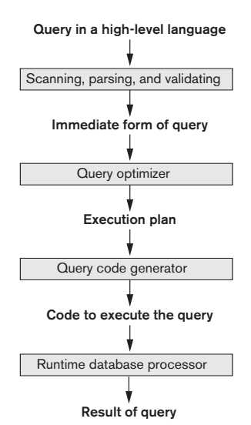

Slide 4
Importance of Query Optimization
The goal of query optimization is to reduce the system resources required to fulfill a query, and ultimately provide the user with the correct result set faster.
First, it provides the user with faster results, which makes the application seem faster to the user.
Secondly, it allows the system to service more queries in the same amount of time, because each request takes less time than un-optimized queries.
Thirdly, query optimization ultimately reduces the amount of wear on the hardware (e.g. disk drives), and allows the server to run more efficiently (e.g. lower power consumption, less memory usage).

Slide 5
Way to Optimize the Query
Analyze and transform equivalent relational expressions: Try to minimize the tuple and column counts of the intermediate and final query processes.
Using different algorithms for each operation: These underlying algorithms determine how tuples are accessed from the data structures they are stored in, indexing, hashing, data retrieval and hence influence the number of disk and block accesses (discussed in query processing).

Slide 6
Translating SQL Queries into Relational Algebra
SELECT Lname, Fname FROM EMPLOYEE WHERE Salary > ( SELECT MAX (Salary) FROM EMPLOYEE WHERE Dno=5 );
First Decomposition has been performed on this query.
1. ( SELECT MAX (Salary) FROM EMPLOYEE WHERE
Dno=5 )
2. SELECT Lname, Fname FROM EMPLOYEE WHERE Salary > c

Slide 7
ℑ _{MAX Salary}(σ_{Dno=5}(EMPLOYEE))
Π _{Lname,Fname}(σ_{Salary>c}(EMPLOYEE))

Slide 8
Equivalence Rules
Conjunctive selection operations can be deconstructed into a sequence of individual selections.
Selection operations are commutative.
Only the last in a sequence of projection operations is needed, the others can be omitted.
Selections can be combined with Cartesian products and theta joins.
σ_{θ}(E₁ X E₂) = E₁ _{θ} E₂
σ_{θ1}(E₁ _{θ2} E₂) = E₁ _{θ1∧ θ2} E₂

Slide 9
Equivalence Rules
5. Theta-join operations (and natural joins) are commutative. E_{1 θ} E₂ = E₂ _{θ} E₁
6. (a) Natural join operations are associative:
(E₁ E₂) E₃ = E₁ (E₂ E₃) (b) Theta joins are associative in the following manner: (E_{1 θ1} E₂) _{θ2∧ θ3} E₃ = E_{1 θ1∧ θ3} (E₂ _{θ2} E₃) where θ₂ involves attributes from only E₂ and E₃.

Slide 10
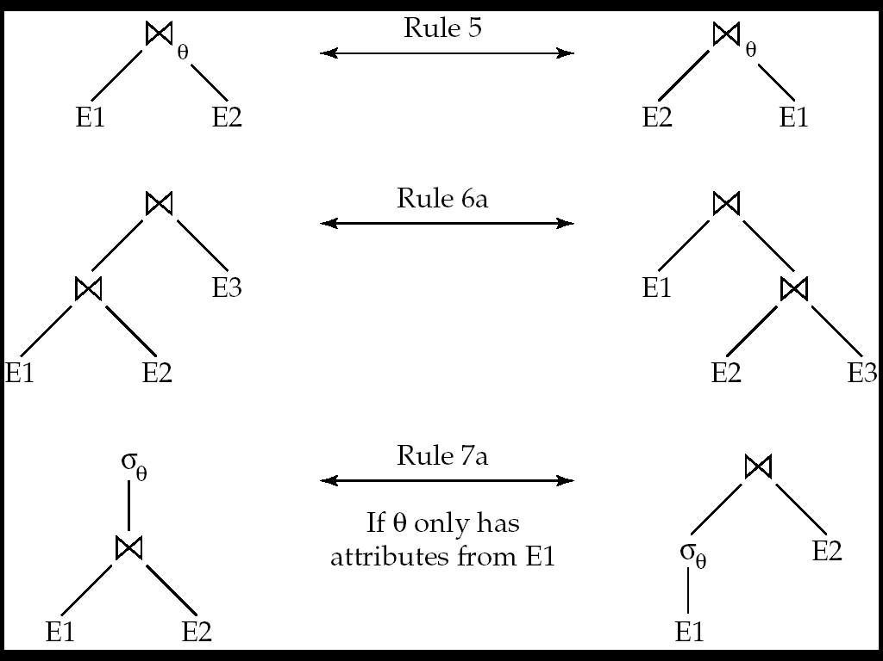
Pictorial Depiction of Equivalence Rules

Slide 11
Equivalence Rules
7. The selection operation distributes over the theta join operation under the following two conditions: (a) When all the attributes in θ₀ involve only the attributes of one of the expressions (E₁) being joined.
σ_{θ0}(E₁ _{θ} E₂) = (σ_{θ0}(E₁)) _{θ} E₂
(b) When θ ₁ involves only the attributes of E₁ and θ₂ involves only the attributes of E₂.
σ_{θ1}∧_{θ2} (E₁ _{θ} E₂) = (σ_{θ1}(E₁)) _{θ} (σ_{θ2} (E₂))

Slide 12
Equivalence Rules
8. The projection operation distributes over the theta join operation as follows:
(a) if θ involves only attributes from L₁ ∪ L₂:
(b) Consider a join E_{1 θ} E₂.
Let L₁ and L₂ be sets of attributes from E₁ and E₂, respectively.
Let L₃ be attributes of E₁ that are involved in join condition θ, but are not in L₁ ∪ L₂, and
let L₄ be attributes of E₂ that are involved in join condition θ, but are not in L₁ ∪ L₂.
∏
(
E
E
)
=
(
∏
(
E
))
(
∏
(
E
))
L
1
∪
L
2
1
θ
2
L
1
1
θ
L
2
2
∏
(
E
E
)
=
∏
((
∏
(
E
))
(
∏
(
E
)))
L
1
∪
L
2
1
θ
2
L
1
∪
L
2
L
1
∪
L
3
1
θ
L
2
∪
L
4
2

Slide 13
Equivalence Rules
9. The set operations union and intersection are commutative E₁ ∪ E₂ = E₂ ∪ E₁ E₁ ∩ E₂ = E₂ ∩ E₁
(set difference is not commutative).
10. Set union and intersection are associative.
(E₁ ∪ E₂) ∪ E₃ = E₁ ∪ (E₂ ∪ E₃) (E₁ ∩ E₂) ∩ E₃ = E₁ ∩ (E₂ ∩ E₃)
11. The selection operation distributes over ∪, ∩ and –. σ_{θ} (E₁ – E₂) = σ_{θ} (E₁) – σ_{θ}(E₂) and similarly for ∪ and ∩ in place of – Also: σ_{θ} (E₁ – E₂) = σ_{θ}(E₁) – E₂ and similarly for ∩ in place of –, but not for ∪
12. The projection operation distributes over union
Π_{L}(E₁ ∪ E₂) = (Π_{L}(E₁)) ∪ (Π_{L}(E₂))

Slide 14
There are two methods of query optimization
Cost based Optimization (Physical)
Heuristic Optimization (Logical)

Slide 15
Cost based Optimization (Physical)
It is based on the cost of the query.
The query can use different paths based on indexes, constraints, sorting methods etc.
This method mainly uses the statistics like record size, number of records, number of records per block, number of blocks, table size, whether whole table fits in a block, organization of tables, uniqueness of column values, size of columns etc.

Slide 16
Cost difference between evaluation plans for a query can be enormous
Steps in cost-based query optimization
Generate logically equivalent expressions using equivalence rules
Annotate resultant expressions to get alternative query plans
Choose the cheapest plan based on estimated cost
Estimation of plan cost based on:
Statistical information about relations. Examples:
number of tuples, number of distinct values for an attribute
Statistics estimation for intermediate results
to compute cost of complex expressions
Cost formulae for algorithms, computed using statistics

